Slide 1
Image Classification and Retrieval Using SURF

Slide 2
Presentation Outline
Introduction
Image Classification
Image Retrieval
Content-based image retrieval
Feature extraction
Current Systems
SURF
Conclusion

Slide 3
Introduction: Image Databases
Image databases, once an expensive proposition, in terms of space, cost and time has now become a reality.
Image databases, store images of a various kinds.
These databases can be searched interactively, based on image content or by indexed keywords.

Slide 4
Classification & Retrieval
Image classification has a wide range of applications, for example, video surveillance, image and video retrieval, web content analysis etc.
In image retrieval, using labeled dataset, once the class of the query image is identified then for the retrieval from dataset, search has to be made only within that class. The image classification plays a good role in image retrieval.
Image Categorization????

Slide 5
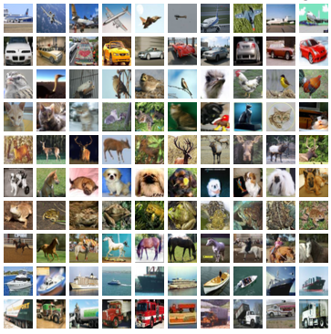

Slide 6
Databases Examples:
Art collection – paintings could be searched by artists, genre, style, color etc.
Medical images – searched for anatomy, diseases.
Satellite images – for analysis/prediction.
General – you want to write an illustrated report.

Slide 7
Types Image Retrieval
Keyword/Text Based Search.
Object/Content Based Search.

Slide 8
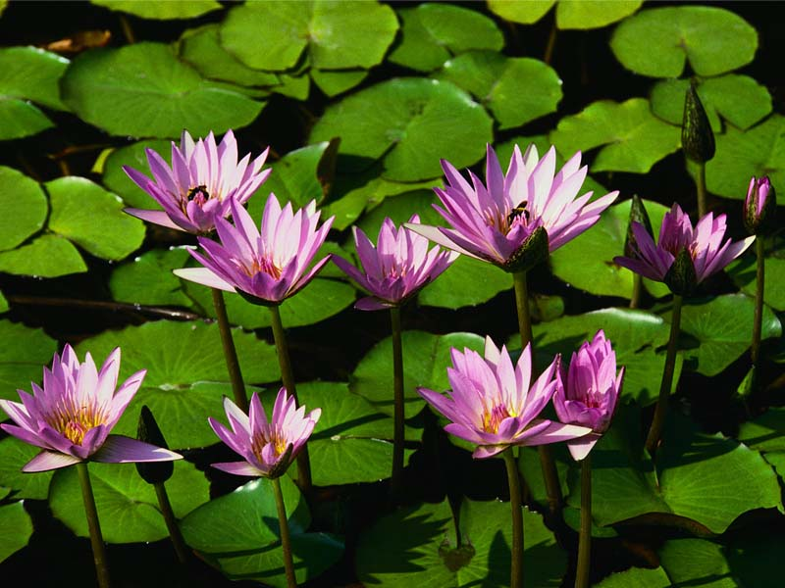

Traditional Image Retrieval
Traditional text-based image search engines
  Manual annotation of images
  Use text-based retrieval methods
E.g.
Water lilies
Flowers in a pond
<Its biological name>

Slide 9
Limitations of text-based approach
Problem of image annotation
  Large volumes of databases
  Valid only for one language – with image retrieval this limitation should not exist
Problem of human perception
  Subjectivity of human perception
  Too much responsibility on the end-user
Problem of deeper (abstract) needs
  Queries that cannot be described at all, but tap into the visual features of images.

Slide 10
What is CBIR?
Search by Images Content.
Content can be extracted from image using various ways :
  Gray Histogram, Color Histogram, Object Description, Texture, Edge Information etc
Each image will now be described by its own features.

Slide 11
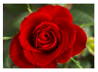
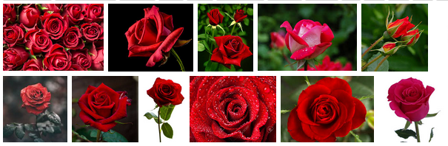
CBIR – A sample search query
Query Image
Retrieved Image

Slide 12
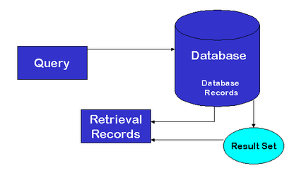
Image Retrieval System
Features of the Images

Slide 13
Feature Extraction
What are image features?
Primitive features
  Mean color (RGB)
  Color Histogram
Semantic features
  Color Layout, texture etc…
Domain specific features
  Face recognition, fingerprint matching etc…
General features

Slide 14
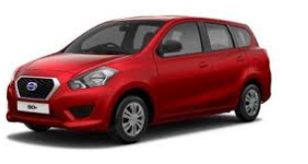

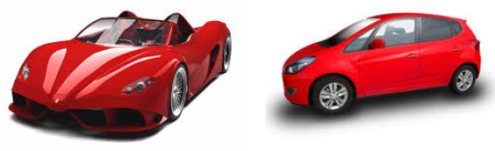
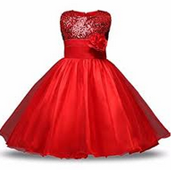
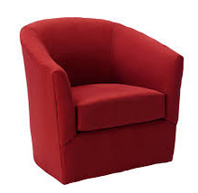
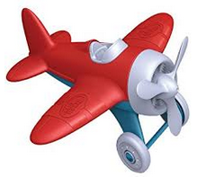
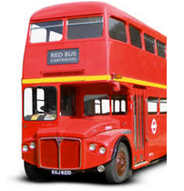
Color based search: Issues
Query Image
Retrieved Image

Slide 15
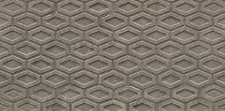
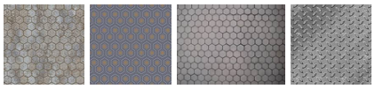


Texture Based issues:
Query Image
Retrieved Images

Slide 16


Shape Based issues
Retrieved Images
Query Image

Slide 17
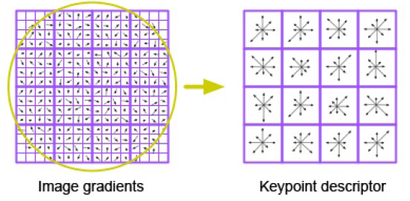
Scale Invariant Feature Transform (SIFT)
Take a 16 x16 window around interest point (i.e., at the scale detected).
Divide into a 4x4 grid of cells.
Compute histogram of image gradients in each cell (8 bins each).
16 histograms x 8 orientations
= 128 features

Slide 18
Properties of SIFT
Highly distinctive
  A single feature can be correctly matched with high probability against a large database of features from many images.
Scale and rotation invariant.
Partially invariant to 3D camera viewpoint
  Can tolerate up to about 60 degree out of plane rotation
Partially invariant to changes in illumination
Can be computed fast and efficiently.

Slide 19
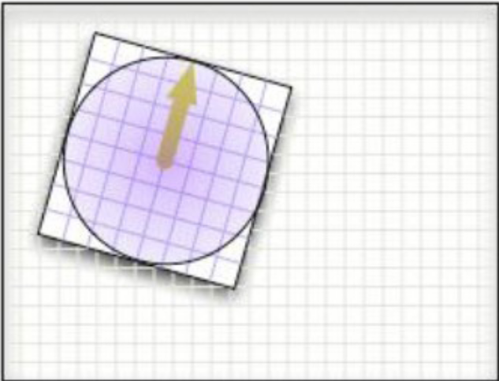
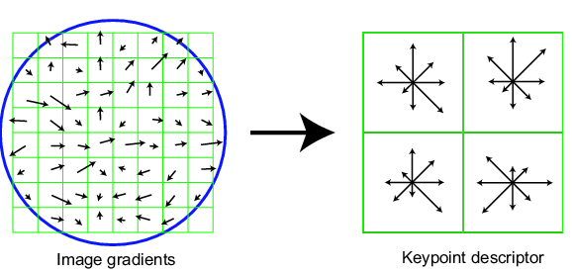
Keypoint Descriptor
8 bins

Slide 20
Keypoint Descriptor
Descriptor depends on two main parameters:
(1) number of orientations r
(2) n x n array of orientation histograms
rn²
features
SIFT: r=8, n=4
128 features
Thus they are Invariant to linear illumination changes

Slide 21
Applications of SIFT
Object recognition
Object categorization
Location recognition
Robot localization
Image retrieval
Image panoramas

Slide 22
SURF: Speeded Up Robust Features
Interest Point Descriptor.
Used for Image Matching.
Speed-up computations by fast approximation of
(i) Hessian matrix and
(ii) descriptor using “integral images”.

Slide 23
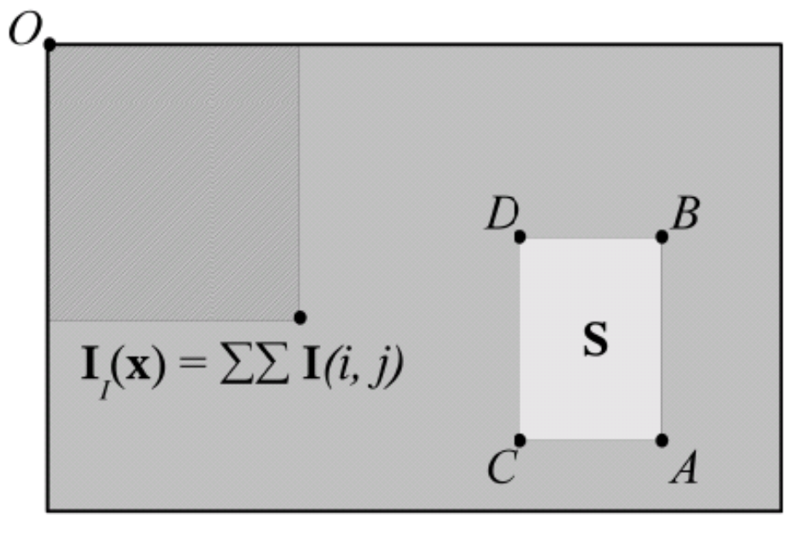

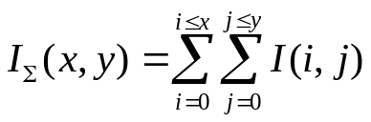
Integral Image
The integral image I_{Σ}(x,y) of an image I(x, y) represents the sum of all pixels in I(x,y) of a rectangular region formed by (0,0) and (x,y).

Slide 24
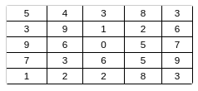
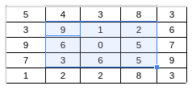
we want to calculate average intensity over the area highlighted in blue
Normally, you'd do the following :
9 + 1 + 2 + 6 + 0 + 5 + 3 + 6 + 5 = 37
37 / 9 = 4.11
That required a total of 9 operations.
Doing the same for 100 such operations would require 100 * 9 = 900 operations.

Slide 25
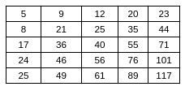
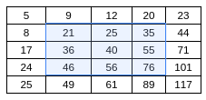
Now, let us first make a integral image of the above image
Making this image required a total of 56 operations.
Again, focus on the highlighted portion
To calculate avg intensity, all you have to do is
(76 - 20) - (24 - 5) = 37
37 / 9 = 4.11
This required a total of 4 operations.
To do this for 100 such operations would require 56 + 100 * 4 = 456 operations.

Slide 26
Alternatively, we can use filters of larger size on the original image.
Due to using integral images, filters of any size can be applied at exactly the same speed.
Has been reported to be 3 times faster than SIFT.
Less robust to illumination and viewpoint changes compared to SIFT.

Slide 27
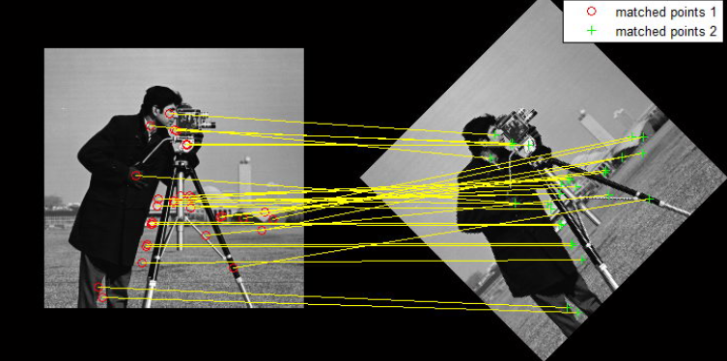

Slide 28
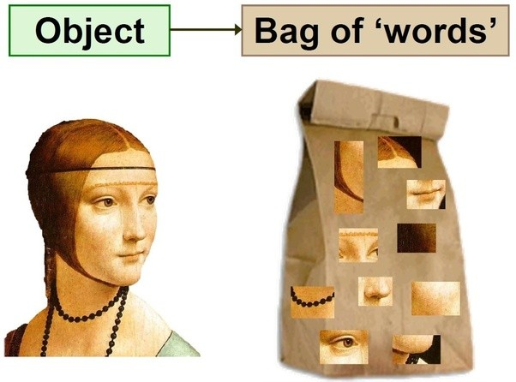
Bag – of - Words

Slide 29
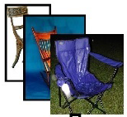
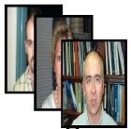
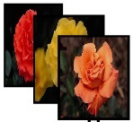



BOW/BOF
BOW using SURF
SURF Key point Identification

Slide 30

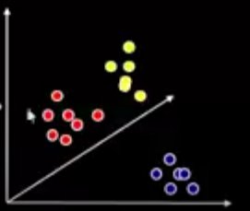
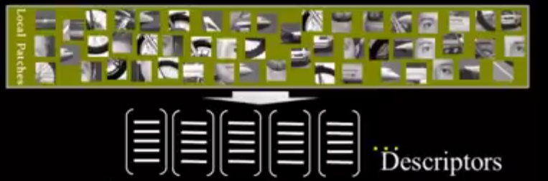
BOW/BOF

Slide 31
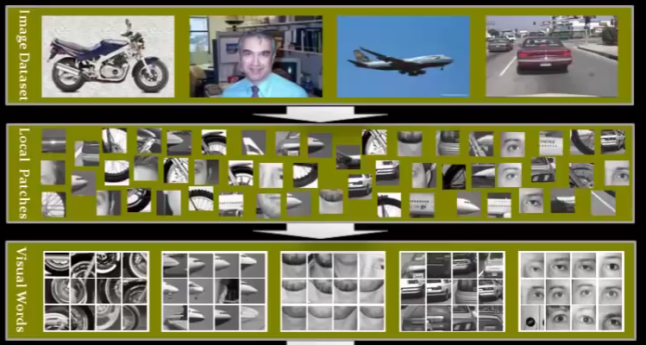

Slide 32
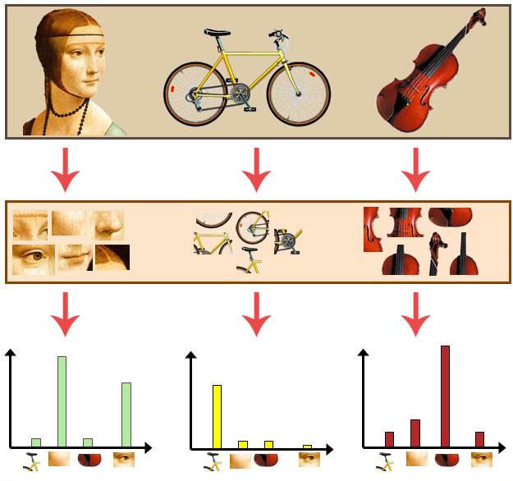

Slide 33
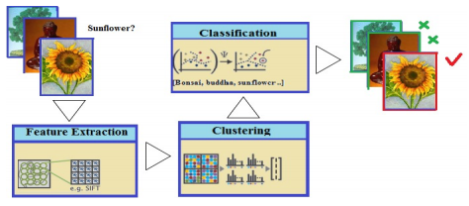
Image Classification

Slide 34
References:
Bay, Herbert, et al. "Speeded-up robust features (SURF)." Computer vision and image understanding 110.3 (2008): 346-359.
Solmaz, Berkan, Soumyabrata Dey, A. Ravishankar Rao, and Mubarak Shah. "ADHD classification using bag of words approach on network features." In Medical Imaging 2012: Image Processing, vol. 8314, p. 83144T. International Society for Optics and Photonics, 2012.
https://gurus.pyimagesearch.com/the-bag-of-visual-words-model/

